Slide 1
Chex Mix: Improving Pneumonia Detection
Blake List and Daniel Bentall

Slide 2
Introduction
Improve pneumonia detection
ChestX-ray14 dataset (based on Wang et al., 2017)
14 thoracic pathologies including pneumonia
Model based on CheXNet (Rajpurkar et al., 2017)
Rajpurkar et al. CheXNet: Radiologist-Level Pneumonia Detection on Chest X-Rays with Deep Learning. 2017.
Wang et al. Chestx-ray8: Hospital-scale chest x-ray database and benchmarks on weakly-supervised classification and localization of common thorax diseases. 2017.

Slide 3
Hypothesis
Using the other disease labels [from ChestX-ray14] as features, and combining them with the final layer activations of the CNN in a logistic regression classifier, will give a significantly higher F1 score than the CNN alone in the classification of pneumonia.
Notes:
Our use case is a model which works in tandem with a radiologist, providing diagnosis suggestions based on a combination of X-ray images and any current diagnosis made by the radiologist. As a proof of concept we aim to show that our model performs better in the classification of pneumonia when other diagnosed disease labels are included.

Slide 4
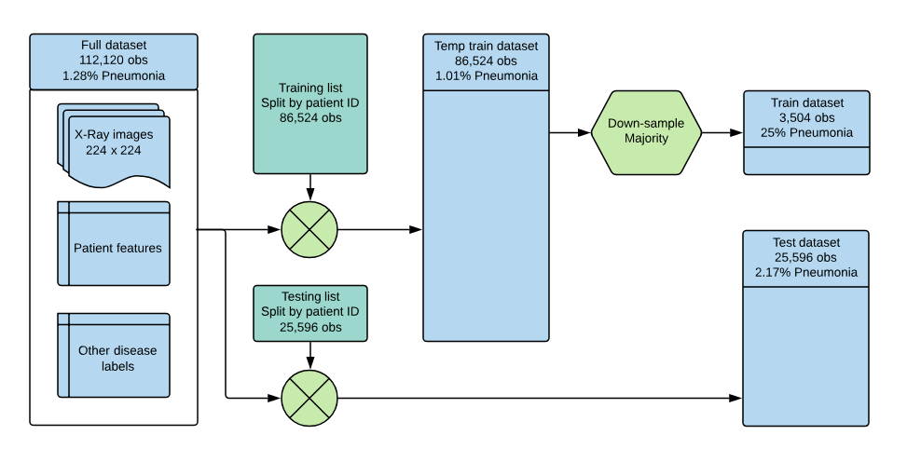
Method: Splitting and Balancing
Notes:
Basic desc of data: 13 other thoracic disease labels as predictors

Slide 5
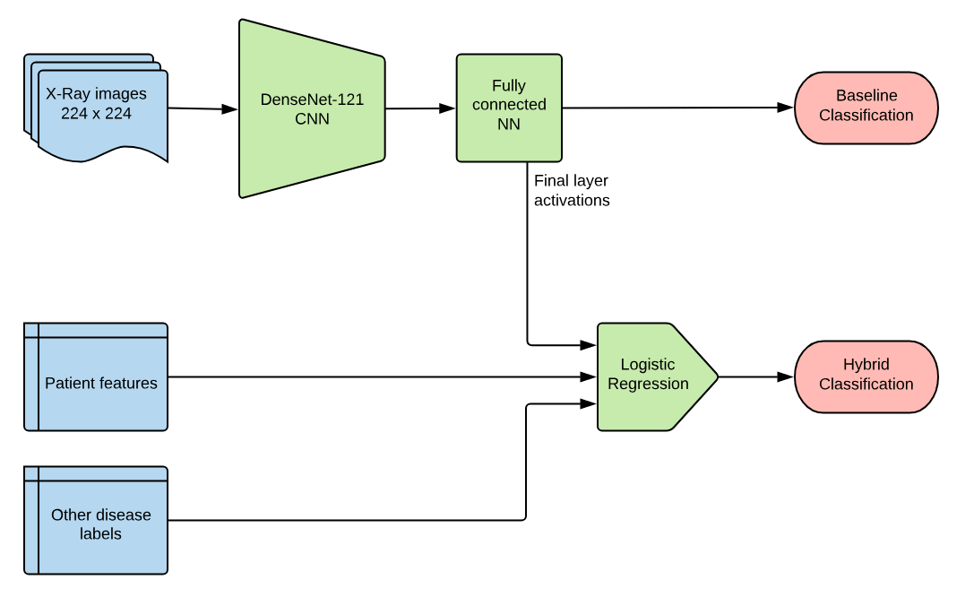
Method: Model Flowchart
Notes:
Remove (20) or replace with (16)
DenseNet-121 used by CheXNet

Slide 6
Method: Training and Testing
Train fully connected NN with frozen DenseNet
Train latter part of DenseNet
Predict on training images and save training activations
Predict on testing images for baseline score and save testing activations
Train logistic regression on training activations
Predict logistic regression on testing activations and produce hybrid score

Slide 7
Results
Baseline CNN F1 score: 0.210
Hybrid F1 score: 0.332
CheXNet F1 score: 0.435
Notes:
Explain use of F1 score
Emphasise that results support hypothesis

Slide 8
Discussion: Technical Issues
Index alignment problems
Memory issues
Hyper-parameter tuning
Notes:
Memory Issues: restricted to 112 x 112 which would lower the scores
Hyper-parameter tuning: every change seemed to make it worse. Freeze certain parameters

Slide 9
Discussion: Dataset Issues
Label accuracy/subjectivity
Lack of information
Patient medical data
Side X-rays
Dataset does not represent use case
Notes:
The dataset does not represent our use case well: our training and testing images generally have strong enough signs of pneumonia that the original radiologist was able to spot it, and images with weaker signs of pneumonia in the dataset may not even be labelled as such. So the images may not exactly represent the scenario we are interested in, but they are the closest we can get, and our hybrid model performs better than the CNN on this data, so it should do the same on a truer dataset or in deployment.

Slide 10
Discussion: Future work
Method refinement
Different CNN configurations
Secondary model selection
Association analysis techniques
Look at disease development
Implications
Pneumonia diagnosis
Other disease diagnosis
Notes:
Association analysis to see how
Implications: using known diagnoses for

Slide 11
Summary
Goal: improve pneumonia detection
Based on the CheXNet model
Improve by considering other diagnosed conditions
Results are promising
Needs further development in collaboration with medical institute

